Slide 1
Crystal Products
A crystal is a solid whose atoms are arranged in a "highly ordered" repeating pattern. These patterns are called crystal systems. If a mineral has its atoms arranged in one of them, then that mineral is a crystal.

Slide 2
Student ID | Name
Student1417420 | Abdullah
Student1395567 | ABDUL WASAY
Student1418200 | MUHAMMAD UMAIR TAUFIQ

Slide 3
Problem Statement
Today, people are drawn to crystals for a number of reasons, including primarily that
they are very beautiful objects and their different shapes, sizes and colours have
proved fascinating and mysterious as well. They can be found in various forms of beautiful jewellery, or on their own in rough uncut specimens that are sometimes used as ornaments to decorate homes.
Crystals are used to enhance the body&#39;s own healing abilities, reduce stress and improve the quality of your life.
They hold a massive amount of energy and those who work with them believe that they have their own individual energy field or personality.
Holding crystals or placing them on your body is thought to promote physical,
emotional and spiritual healing. Crystals supposedly do this by positively interacting with your body&#39;s energy field, or chakra.
While some crystals are said to alleviate stress, others purportedly improve concentration or creativity.
A need is felt to develop a site which will give all necessary information and also will list the various products.

Slide 4
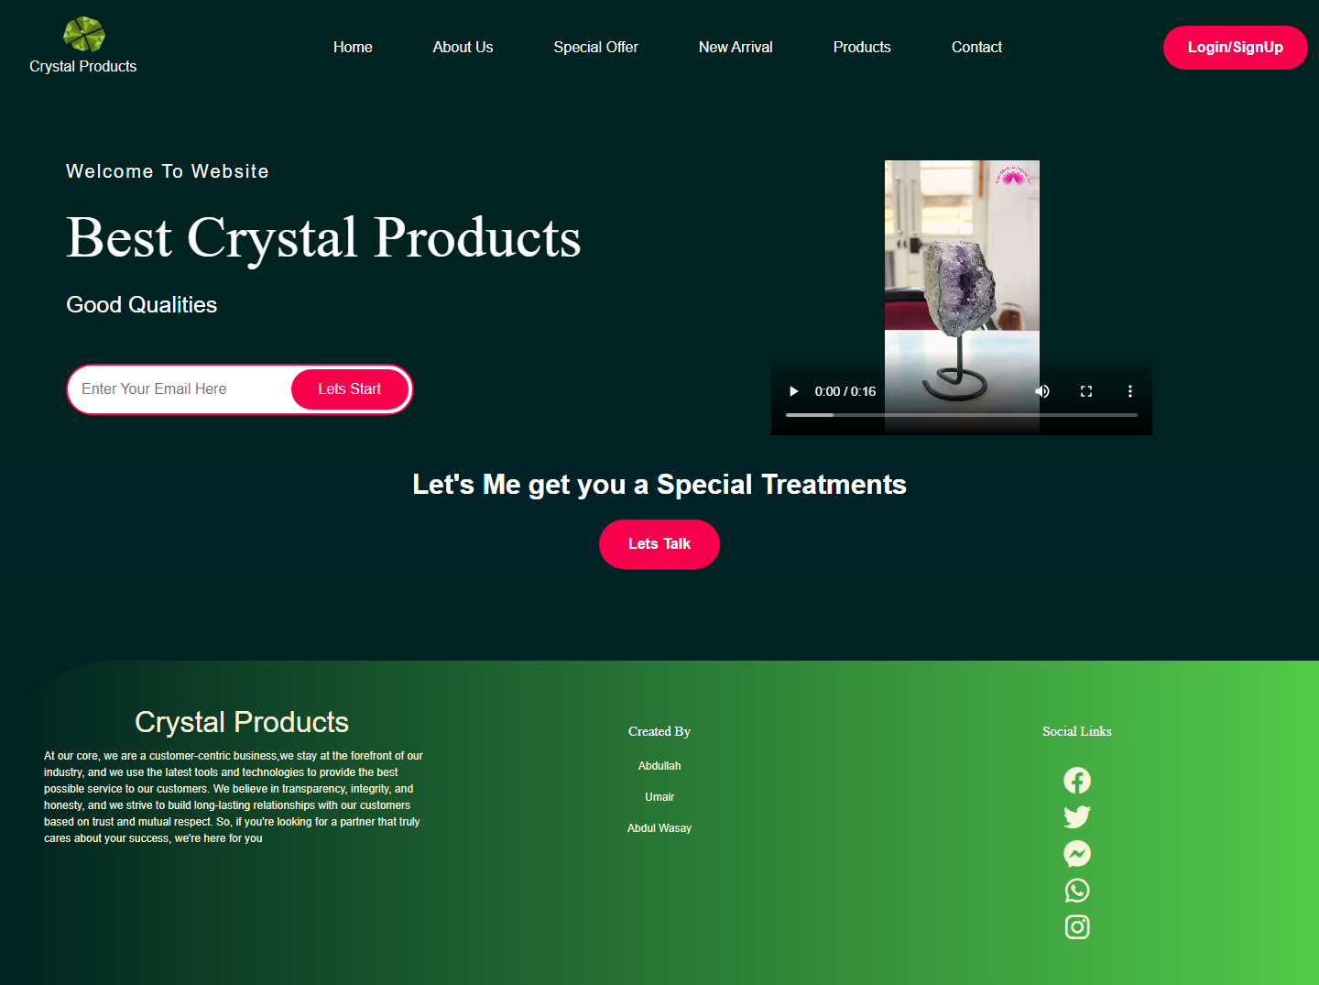
Home Page

Slide 5
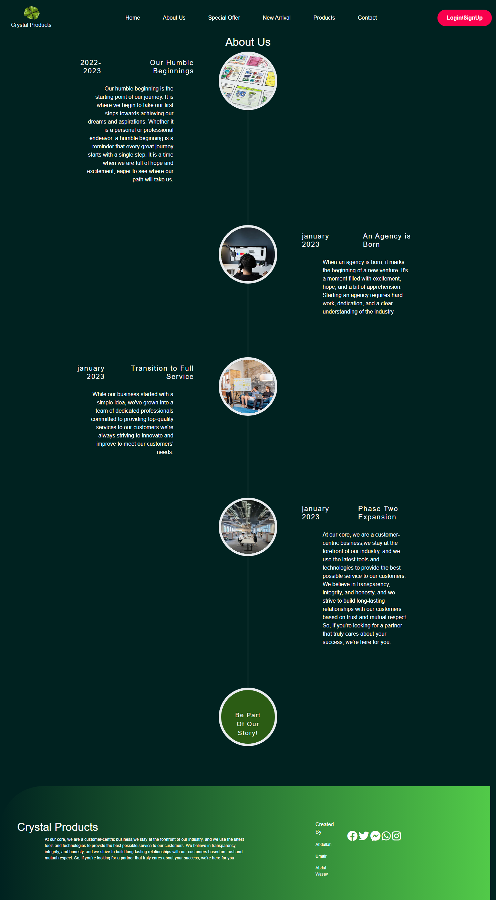
About Us

Slide 6
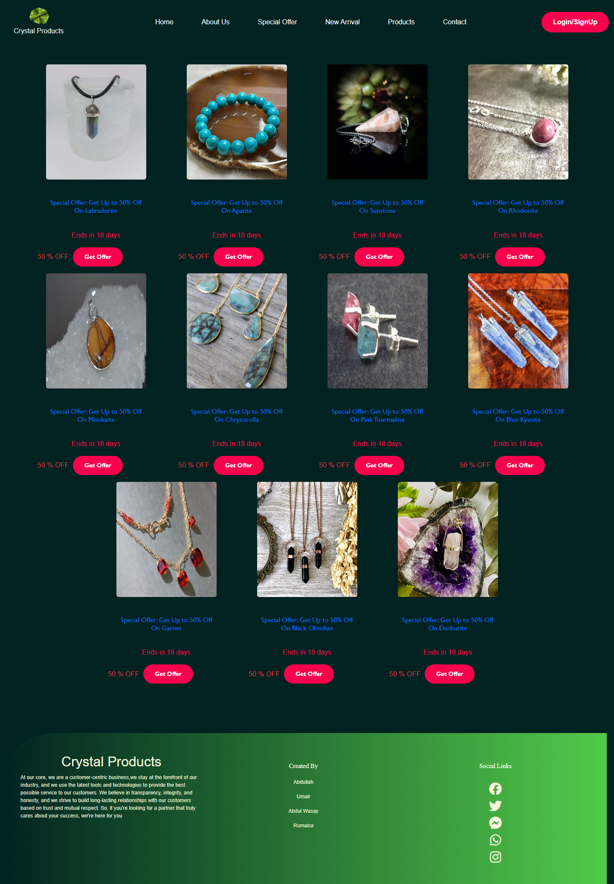
Special Offers

Slide 7
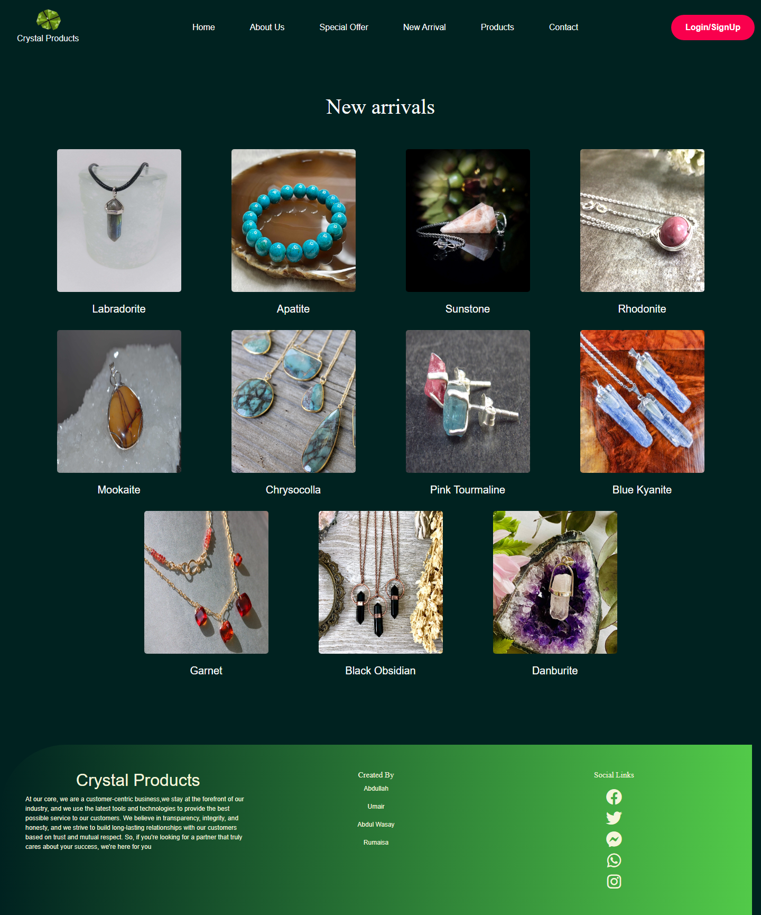
New Arrival

Slide 8
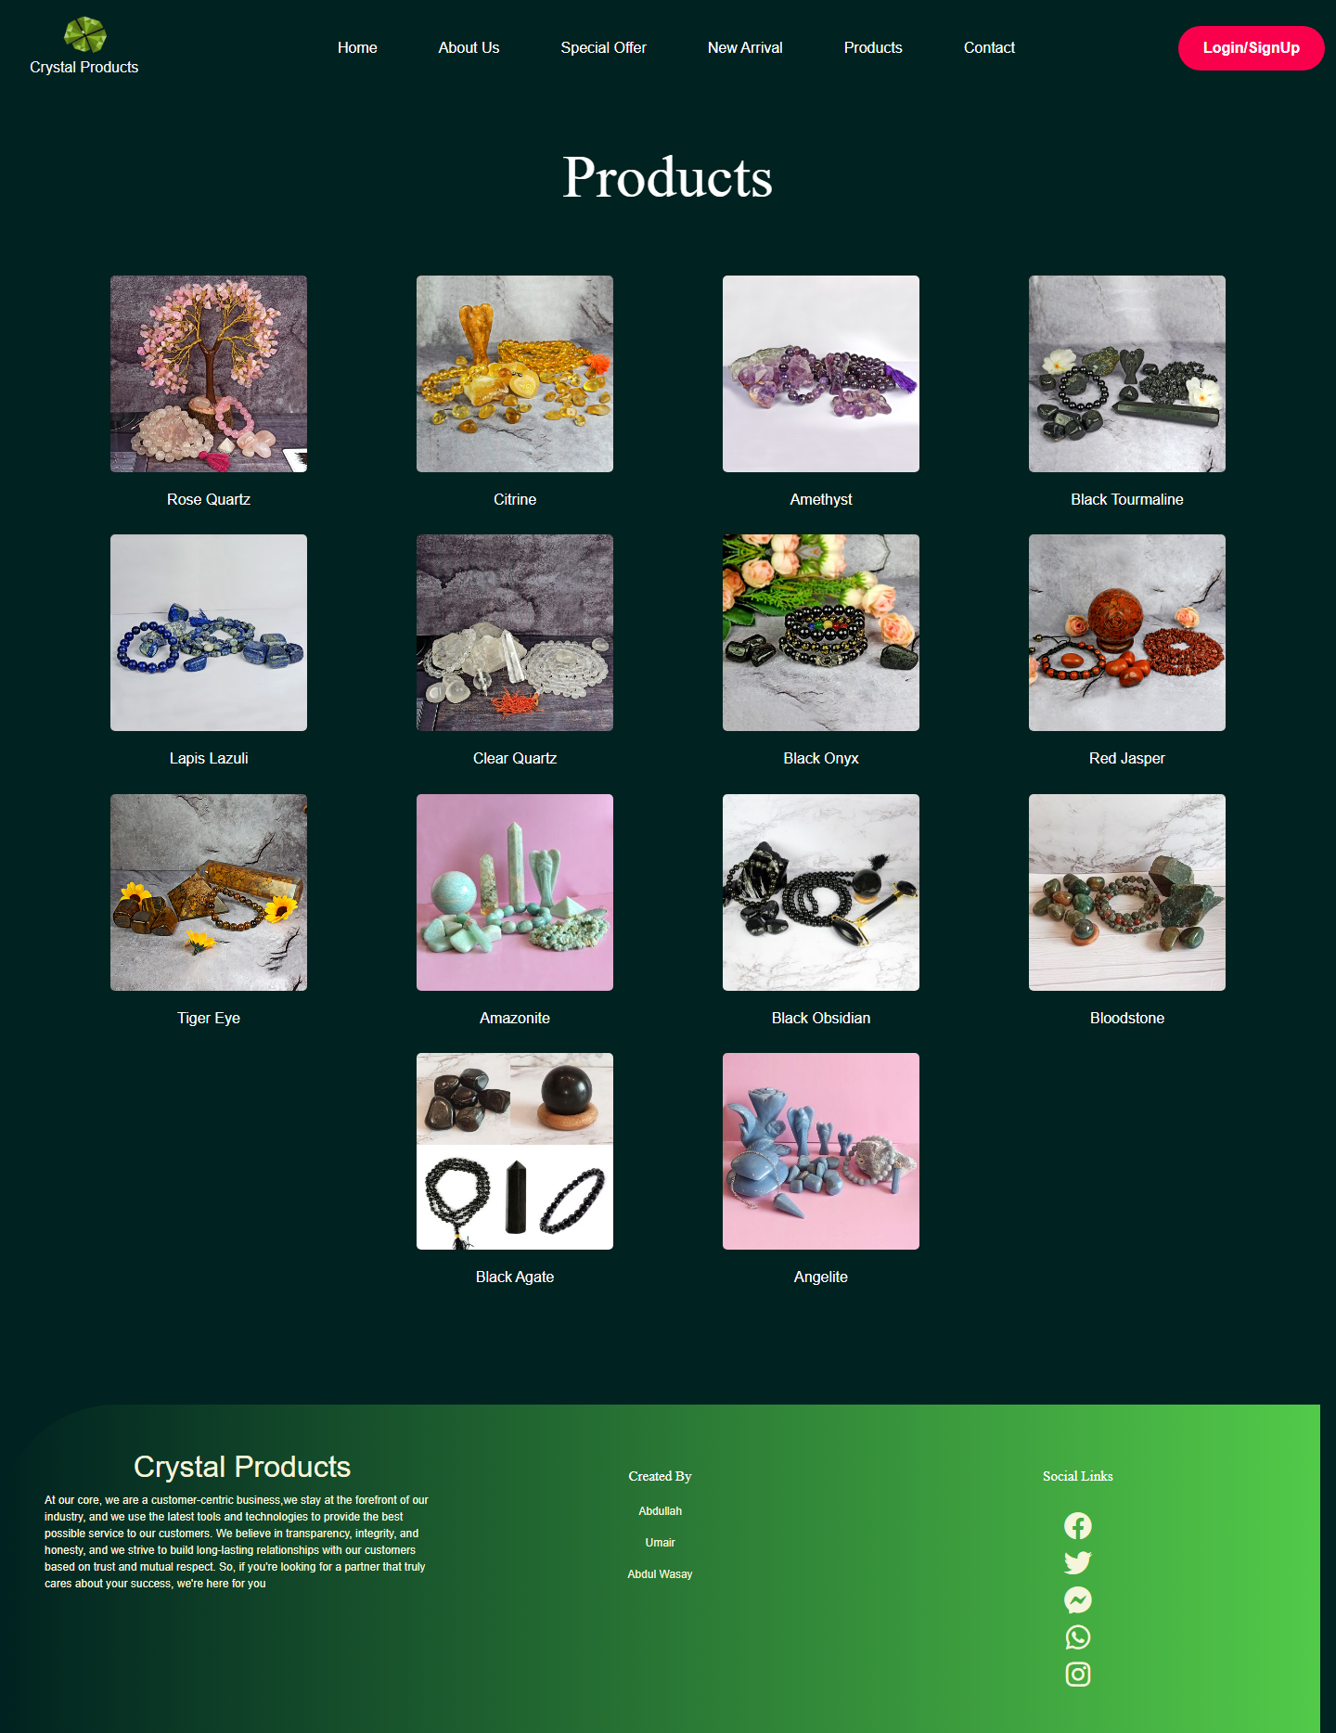
Products

Slide 9
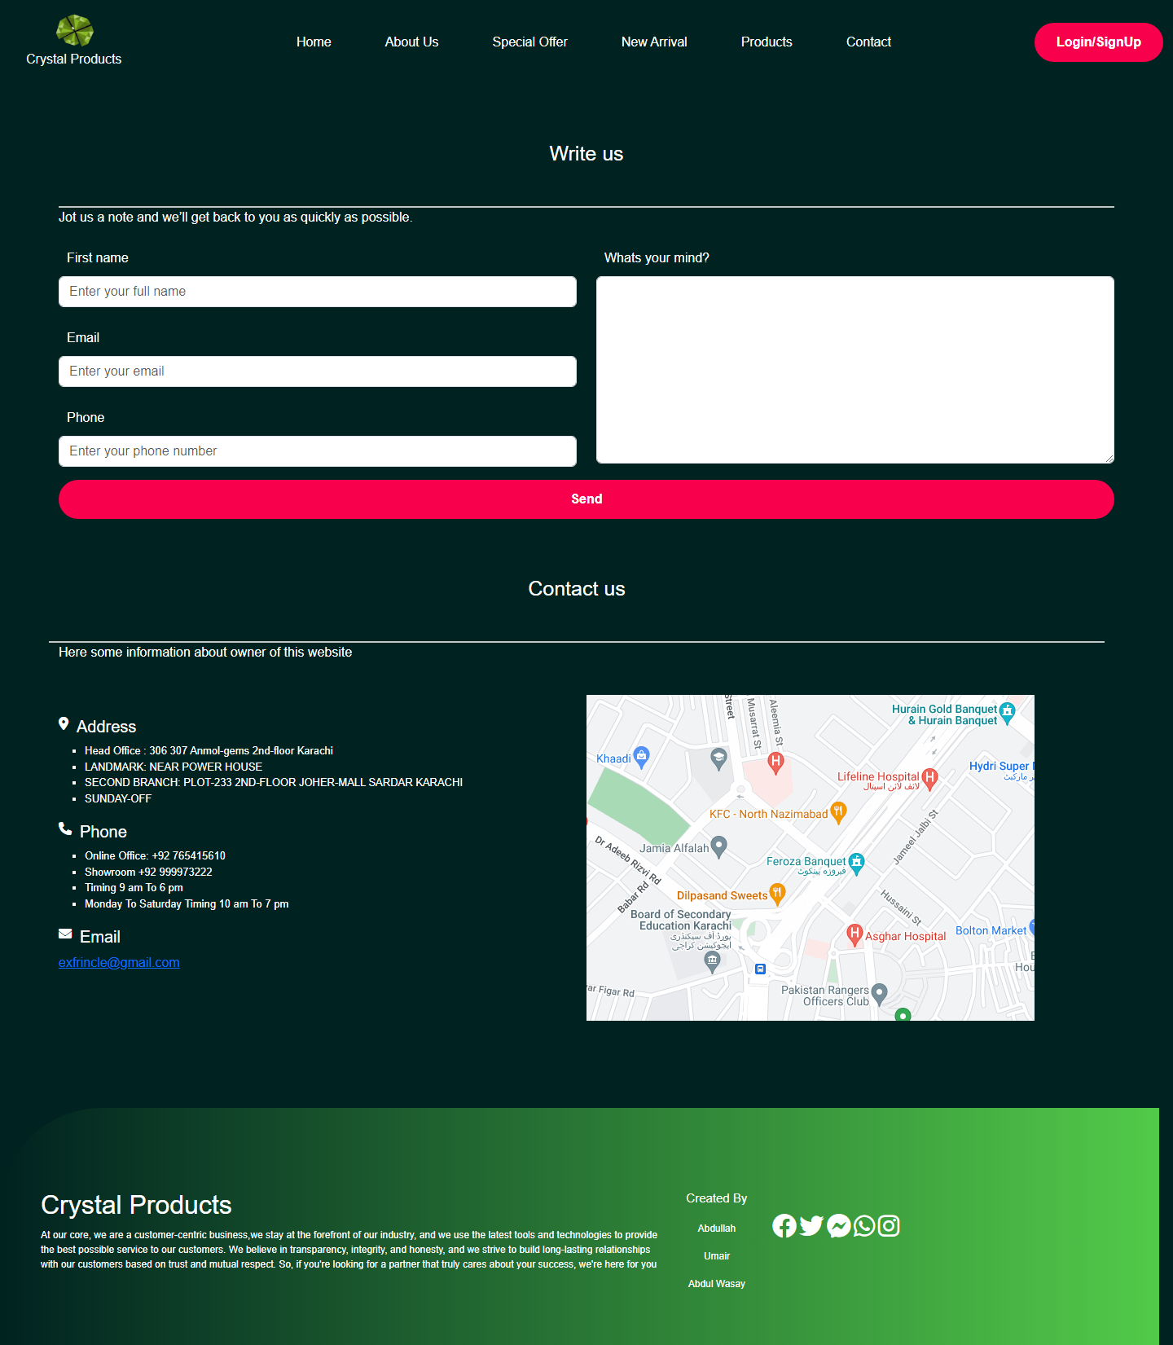
Contact

Slide 10
Student | URL
Abdullah | Std1417420.aptech-students.com
MUHAMMAD UMAIR TAUFIQ | Std1418200.aptech-students.com
ABDUL WASAY | Std1395567.aptech-students.com

